Slide 1
Units
The seven SI base units are:
  kilogram kg
  meter m
  second s
  ampere A
  kelvin K
  mole mol
  candela cd

Slide 2
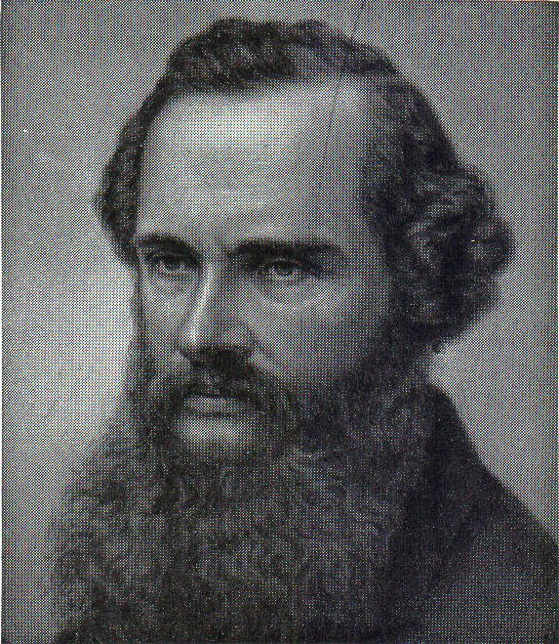
William Thomson (Lord Kelvin) 1824-1907 Irish mathematical physicist, engineer and inventor
“When you can measure what you are talking about, and express it in numbers, you know something about it; but when you cannot measure it, when you cannot express it in numbers, your knowledge is of a meager and unsatisfactory kind; it may be the beginning of knowledge, but you have scarcely in your thoughts advanced to the state of Science, whatever the matter may be.”

Slide 3
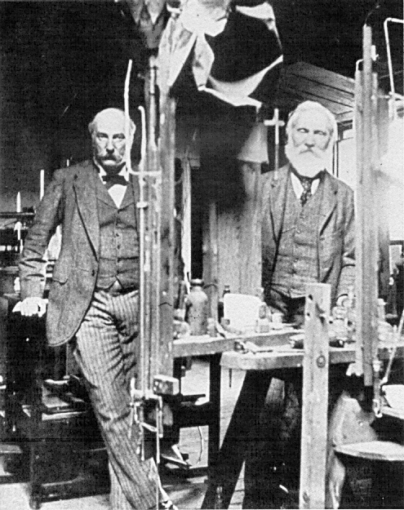
Lord Rayleigh & Lord Kelvin in the Lab at Rayleigh's Estate, Terling (1900)

Slide 4
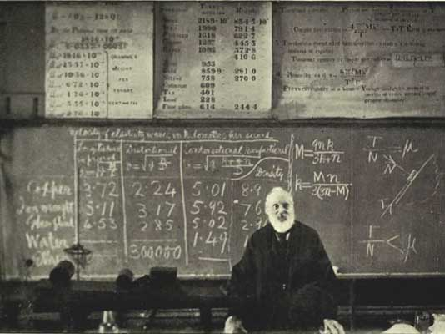
Lord Kelvin giving a lecture

Slide 5
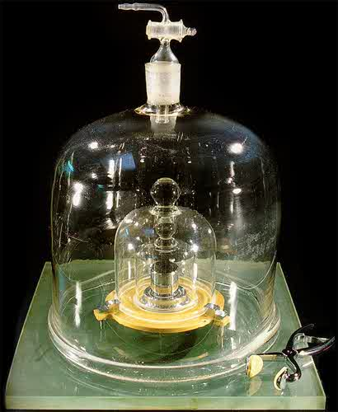
Mass: kilogram (kg)
1 L of water at 4 ºC has a mass of 1 kg
0.1 m
0.1 m
0.1 m
Present definition: The unit of mass is equal to the mass of the international prototype kilogram (a platinum-iridium cylinder) kept at the Bureau International des Poids et Mesures (BIPM), Sèvres, Paris (1st CGPM 1889). It seems to have lost about 50 micrograms in the last 100 years. (NIST has copy number 20). Note that the kilogram is the only base unit with a prefix; the gram is defined as a derived unit, equal to 1/1000 of a kilogram; prefixes such as mega are applied to the gram, not the kg; e.g. Gg, not Mkg. It is also the only unit still defined by a physical prototype instead of a measurable natural phenomenon.

Slide 6
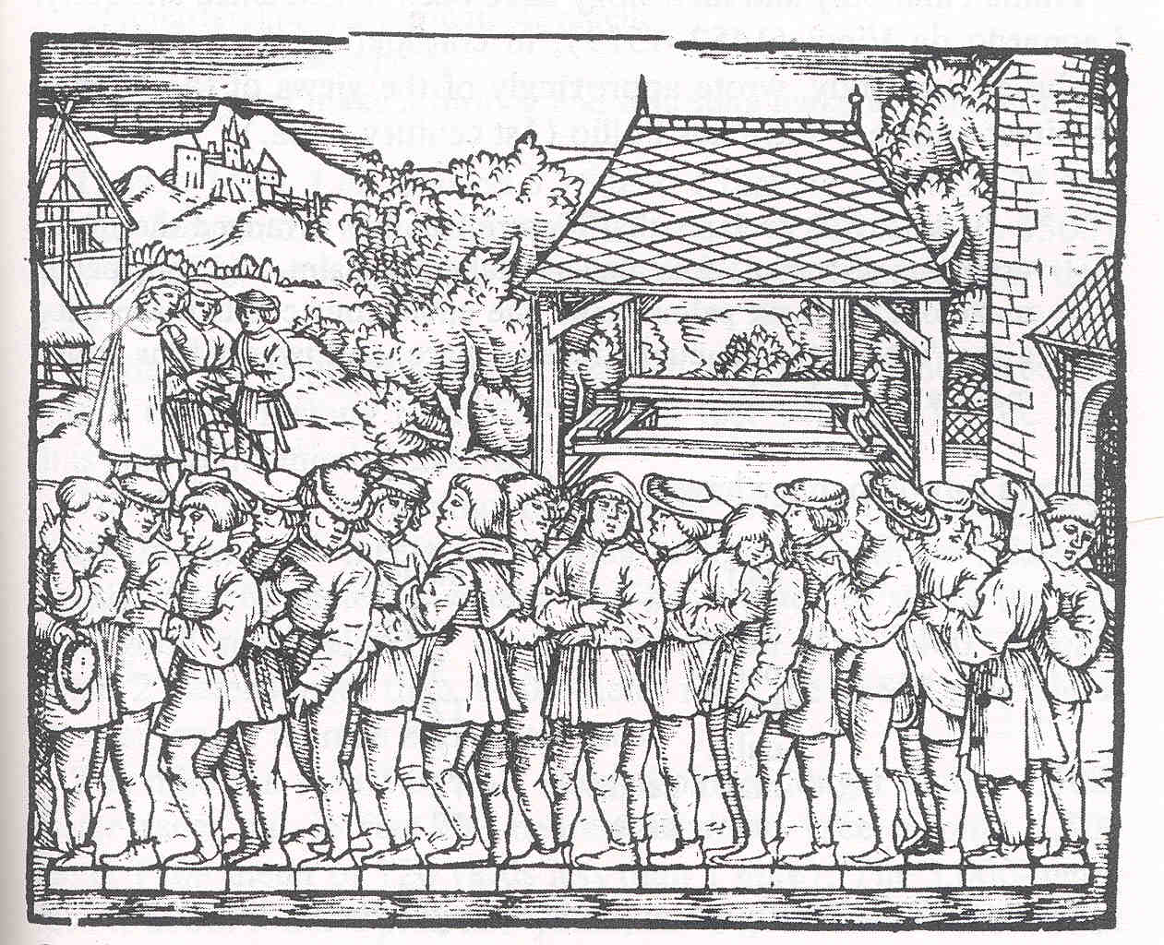
Length

Slide 7
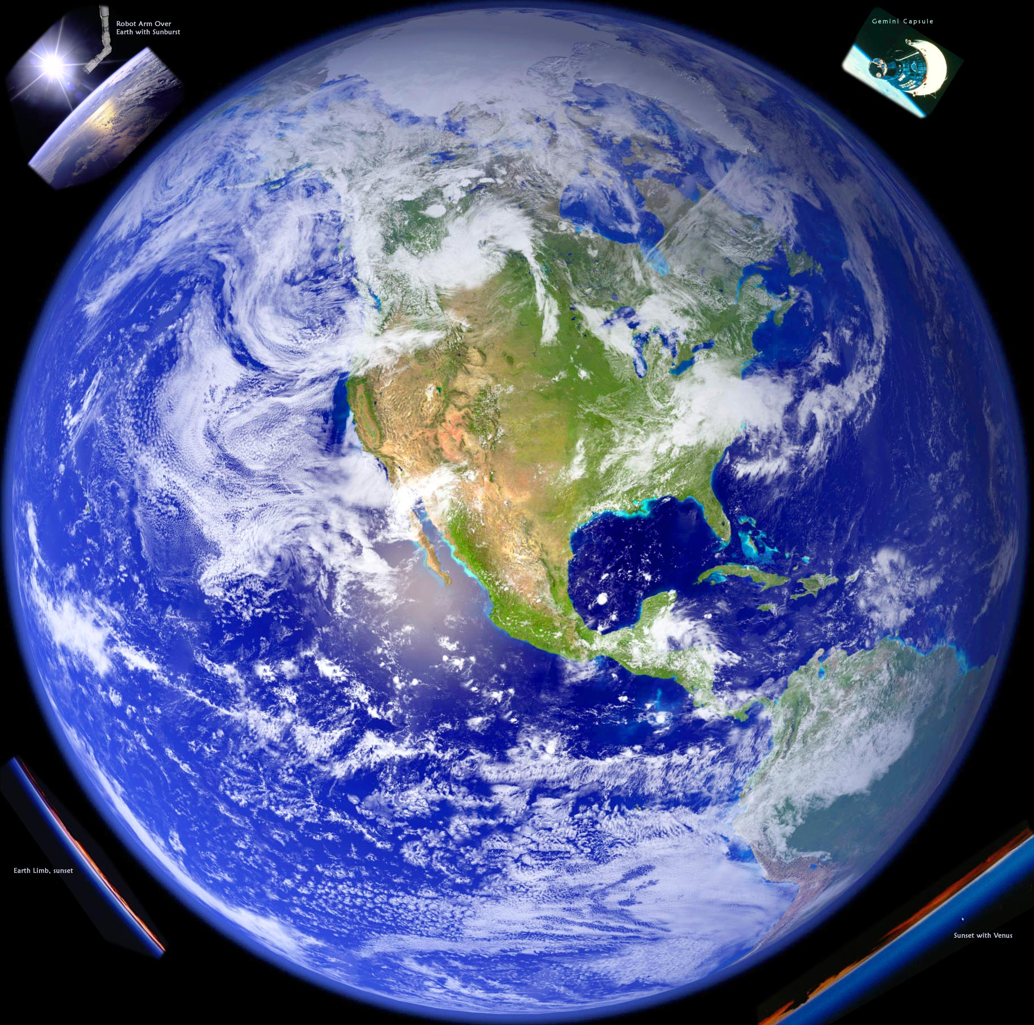
10⁷ m
One meter was originally defined to be equal to 1/10 000 000th of the distance from the pole to the equator along the meridian through Paris.

Slide 8
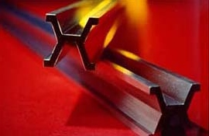
Length: meter (m)
The International Prototype Meter standard bar made of platinum-iridium (measured at 0 ºC) was the standard until 1960.
Present definition: The meter is the length of the path traveled by light in vacuum during a time interval of 1/299 792 458 of a second.
Note that this definition exactly fixes the speed of light in a vacuum at 299,792,458 m/s. Definitions based on the physical properties of light are more precise and reproducible because the properties of light are considered to be universally constant.

Slide 9
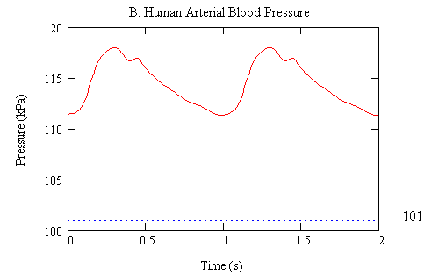
Time: second (s)
The hour had previously been defined by the Egyptians in terms of the rotation of the Earth as 1/24 of a mean solar day. This made the second 1/86,400 of a mean solar day.
1 second = 1 s
Present definition: The duration of 9,192,631,770 periods of the radiation corresponding to the transition between the two hyperfine levels of the ground state (zero magnetic field) of the caesium-133 atom at rest and at a temperature of 0 K

Slide 10
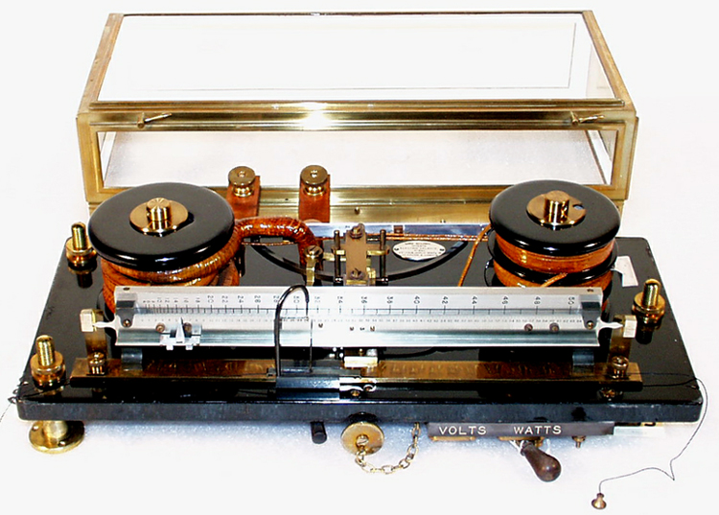
Current
Lord Kelvin's current balance used two electrical currents flowing through two sets of wire coils. This created opposing magnetic fields above and below two plates attached to the balance arm (silver arm in front). The balance of the arm was adjusted with small weights, in order to bring the front arm to the 0 position. The amount of weight this required gave a direct comparison of the two currents flowing in the coils.

Slide 11
Electrical Current: ampere (A)
The ampere is that constant current which, if maintained in two straight parallel conductors of infinite length, of negligible circular cross-section, and placed 1 m apart in vacuum, would produce between these conductors a force equal to 2 x 10^{–7} N per m of length.
Present definition: the ampere is exactly 6.241 509 629 152 65 × 10¹⁸ elementary charges per second.

Slide 12
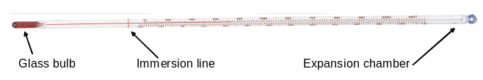
Temperature: kelvin (K)
The unit of temperature became the centigrade or inverted Celsius grade, which means the mercury scale is divided into 100 equal-length parts between the water-ice mixture at 0 °C and the boiling point of pure, distilled water at 100 °C (under a standard atmosphere). This is the metric unit of temperature in everyday use. A hundred years later, the discovery of absolute zero prompted the establishment of a new temperature scale, the Kelvin Scale which relocates the zero point at absolute zero, with the difference between freezing and boiling water close to 100 K.
Present definition: The kelvin unit of thermodynamic temperature (or absolute temperature) is the fraction 1/273.16 (exactly) of the thermodynamic temperature at the triple point of water

Slide 13
Amount of a Substance: mole (mol)
The mole is the amount of substance of a system which contains as many elementary entities as there are atoms in 0.012 kilogram of carbon 12.
When the mole is used, the elementary entities must be specified and may be atoms, molecules, ions, electrons, other particles, or specified groups of such particles.
The number of atoms in 0.012 kilogram of carbon 12 is Avogadro's number. It is approximately 6.0221415 × 10²³

Slide 14
Luminous Intensity: candela (cd)
The unit of luminous intensity is the luminous intensity, in a given direction, of a source that emits monochromatic radiation of frequency 540×10¹² Hz and that has a radiant intensity in that direction of 1/683 W per steradian (sr).
A lumen (lm) is a SI derived unit of luminous flux which is the total amount of visible light (weighted according to human visual sensitivity to various wavelengths) emitted from a source.
1 lm = 1 cd.sr
The SI unit of illuminance is the Lux (lx)
1 lx = 1 lm/m²
A source emitting 1 cd of light in all directions = 12.57 lm

Slide 15
1 atm
29.921 inHg
14.696 lb/in²
1013.2 mbar
1.0132 kg/cm²
1013.2 hPa
101.32 kPa
0.10132 MPa
1.0132 × 10⁵ Pa
1.0132 × 10⁵ N/m²
1.0132 × 10⁵ N.m⁻²

Slide 16
1 atm
☹
☹
29.921 inHg
☹
14.696 lb/in²
☹
1013.2 mbar
☹
1.0132 kg/cm²
☹
1013.2 hPa
☺
101.32 kPa
☺
0.10132 MPa
1.0132 × 10⁵ Pa
☺
1.0132 × 10⁵ N/m²
☺
1.0132 × 10⁵ N.m⁻²
☺

Slide 17
Mathcad Units

Slide 18
Significant Figures

Slide 19
20.01 mV 4 significant figures
20.010 mV 5 significant figures
0.02001 V 4 significant figures
0.020010 V 5 significant figures
2.001×10⁻² V 4 significant figures
2.0010×10⁻² V 5 significant figures

